Slide 1
How to bake my web research
Yevhen Krupin
Tobii Pro Desktop R&D, Kyiv
1
Notes:
Hello everyone! Glad to see you
Let me introduce myself. My name is Yevhen, I work in Tobii pro desktop Rnd in Kyiv, my team work on Tobii Pro lab

Slide 2
Intro
Short introduction to “Tobii Pro Lab” and Web Stimuli
Notes:
And I would like to start with short introduction to tobii pro lab and web stimuli

Slide 3
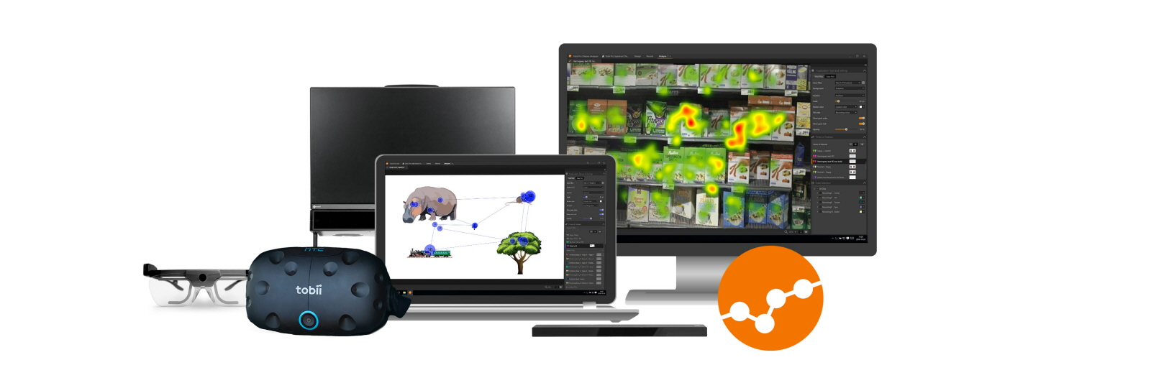
Tobii Pro Lab
Eye tracking software designed for conducting experimental research with Tobii Pro hardware
Source: Tobiipro.com
Notes:
Tobii pro lab – is an eye tracking software for conducting and analyzing experiments in fields such as Vr, marketing, ui/ux, neuroscience etc.

Slide 4
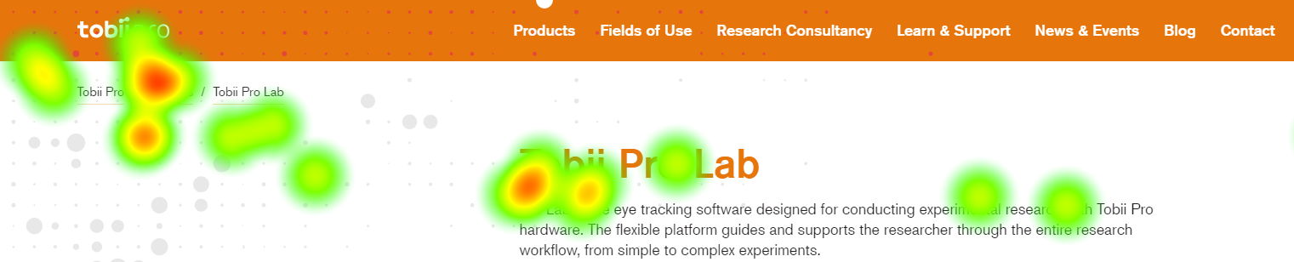
Web Stimuli
To conduct Web/UX research inside of embedded Chromium based browser
To analyze gaze patterns with a powerful analysis toolset
Notes:
Particularly web stimuli is a type of stimuli used to
Conduct web/ux research inside of embedded chromium based browser and to analyze gaze patterns with a powerful analysis toolset

Slide 5
Embedded Browser
Why did we choose CefSharp?
CefSharp – C#/C++ wrapper of native CEF (Chromium Embedded Framework)
PROS
Lifecycle and version control
Execute JS and V8 Extensions
Inter-process communication
Headless/offscreen mode
Low level hooks/events
Could be topmost
Rendering as in Chrome
It is open sourced
CONS
Size (~100mb)
No flash support ☹
No MP4/MP3 support by default

Slide 6

Concepts
Tobii Pro Lab analysis definitions
Event types and events
TOI and intervals
AOI and visits
Web/UX research definitions
CEF and CefSharp
Page
Fixed/sticky elements
Viewport and full page size
Read more
Notes:
I would like to describe briefly Tobii pro lab analysis definitions :
I would talk about them a bit later
Now I want to explain web ux concepts in more details
…
To read more about web concepts please follow the link

Slide 7
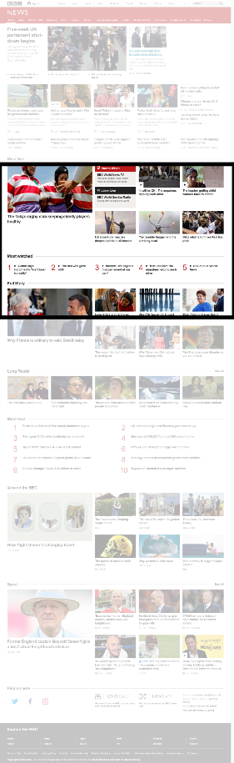
Concepts
Viewport and full page size
Viewport
Full page size
Notes:
As this slide illustrates the viewport is just like a sliding window of visible part of the page inside of full page size
Move on back

Slide 8
Concepts
Tobii Pro Lab analysis definitions
Event types and events
TOI and intervals
AOI and visits
Web/UX research definitions
CEF and CefSharp
Page
Fixed/sticky elements
Viewport and full page size
Read more
Notes:
I would like to describe briefly Tobii pro lab analysis definitions :
I would talk about them a bit later
Now I want to explain web ux concepts in more details
…
To read more about web concepts please follow the link

Slide 9
Concepts
Difference between event types and events
Events (instances)
Click
Open the page (Google.com)
Click
Click
Close the page (Google.com)
Open the page (Tobii.com)
Click
Close the page (Tobii.com)
Stop the recording
Event types (sets)
Clicks
Open the page (Google.com)
Close the page (Google.com)
Open the page (Tobii.com)
Close the page (Tobii.com)
Stop the recording
Notes:
As I’ve mentioned previously let’s look in details what are events and event types.
Imagine you have huge number of things constantly happening during experiment
…
This events could be clasteryzed by attributes to some sets of events and these characteristics such as metadata are particular event types

Slide 10
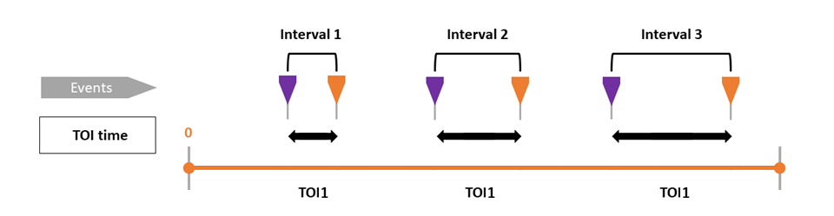
Concepts
Difference between Time of Interest and Interval
Source: Tobiipro.com
Notes:
Time of Interest – is the main concept of lab analysis in terms of time, it means timespans we are interested in
Toi are built by event types and define rules which events starts and ends intervals of this TOI so some data could belong to the same toi but to different intervals

Slide 11
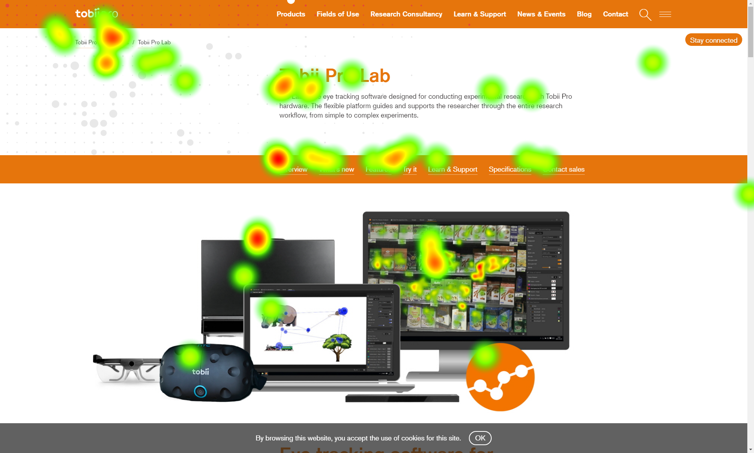
Visualizations
Notes:
What could we use times of interests for? Good idea to use toi to build visualizations

Slide 12
Metrics
Time to first fixation in the scope of TOI
First impression
Intervals count
Fixations count
Fixation duration
etc..
Notes:
Or in order to calculate valuable metrics such as
First impression describes and shows that your participant looked somewhere during first let’s say 3 seconds

Slide 13
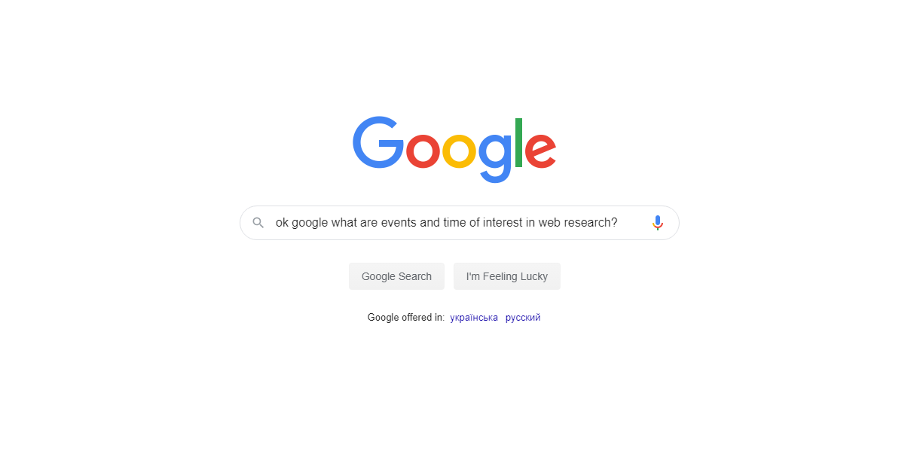
Notes:
Well, very interesting but how could we apply these concepts in web research ?

Slide 14
Web events
Navigation events
Other events
Address change
Title change
Page load start
Page load end
View port change
Mutation
Rendering event
Notes:
Let me attract your attention to referred previously events
Events happening during web study we could face:
Navigation events & other
Viewport change – when participant is scrolling
Mutation – when something changes in the page
Rendering events – when something appears on the screen

Slide 15
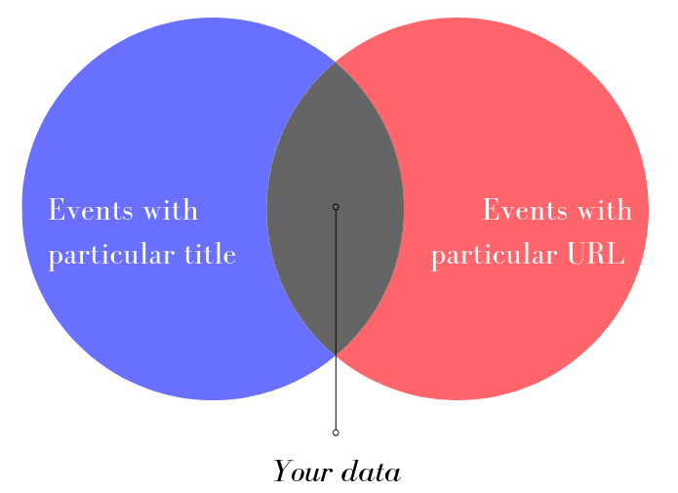
Web events
Notes:
All these events are enriched some metadata: title, url etc.
On the interception of events with particular unique title and particular unique url we have all data which belongs to this particular page and we could say that the page is a web equivalent of TOI

Slide 16
Web events
Type address
tobiipro.com
Async stuff
Some asynchronous requests
Page load
Document is loaded now
Resolve address
https://tobiipro.com
Page load starts
Page is visible
First render event
Title changes

Slide 17
Web events
Type address
tobiipro.com
Async stuff
Some asynchronous requests
Page load
Document is loaded now
Resolve address
https://tobiipro.com
Page load starts
Page is visible
First render event
Title changes
Type address
google.com

Slide 18
Web events
Type address
tobiipro.com
Async stuff
Some asynchronous requests
Page load
Document is loaded now
Resolve address
https://tobiipro.com
Type address
Page load starts
Page is visible
nytimes.com
First render event
Title changes
Type address
google.com

Slide 19
Web events
Still loading
Type address
tobiipro.com
Async stuff
Some asynchronous requests
Page load
Document is loaded now
Resolve address
https://tobiipro.com
Type address
Page load starts
Page is visible
nytimes.com
First render event
Title changes
Type address
google.com

Slide 20
Web events
Type address
tobiipro.com
Async stuff
Some asynchronous requests
Page load
Document is loaded now
Resolve address
Still loading
https://tobiipro.com
Type address
Page load starts
Page is visible
nytimes.com
First render event
Title changes
Type address
google.com

Slide 21
Web events
Type address
tobiipro.com
Async stuff
Some asynchronous requests
Page load
Document is loaded now
Resolve address
Jag är trött på att vänta
https://tobiipro.com
Type address
Page load starts
Page is visible
nytimes.com
First render event
Title changes
Type address
google.com

Slide 22
Web events
Type address
tobiipro.com
Async stuff
Some asynchronous requests
Page load
Document is loaded now
Resolve address
Still loading
https://tobiipro.com
Type address
Page load starts
Page is visible
nytimes.com
First render event
Title changes
Type address
Finally loaded
google.com

Slide 23
Web Navigation TOI
Different Event types and TOIs of different pages
Tobii Home Page
Title: Eye tracking technology for research - Tobii Pro
Address: https://www.tobiipro.com/
Start event | End event
Google
Title: Google
Addess: https://google.com/
Start event | End event
Notes:
While talking about web pages we could say each page is different toi and each page start event and page end event have different event types

Slide 24
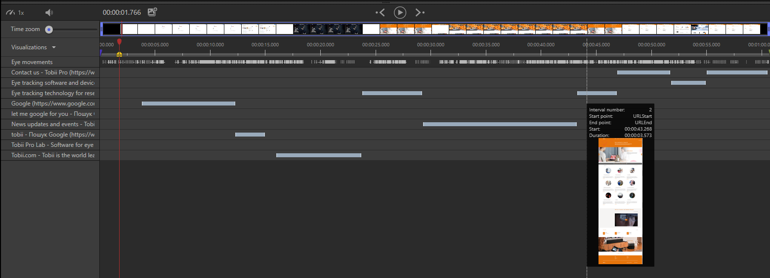
Web Navigation TOI
Visualization of TOI intervals in timeline
Notes:
In tobii pro lab you can see visualization of this concept in replay where you have time of interests by right side and these intervals in the chart
But how to understand when page/toi is started and finished

Slide 25
Naive TOI start
Type address
nytimes.com
Resolve address
https://nytimes.com
Page load
Start TOI
Page load starts
Page is visible
nytimes.com
First render event
Title changes
Notes:
When we were so young and naïve we tried to start time of interest at the moment when the page was loaded it was pretty obvious but
The moment of page load could differ highly from the moment when participant can see the page firstly

Slide 26
Naive TOI start
Type address
nytimes.com
Resolve address
https://nytimes.com
Page load
Start TOI
Page load starts
Page is visible
nytimes.com
First render event
Title changes
Gaze data is skipped
Notes:
So huge interval between first appearance of the page and start toi could be skipped due to this fact
and gaze data would not be taken into account when we calculate metrics or show some visualization

Slide 27
Naive TOI start
Time to first fixation cannot be calculated
First impression cannot be calculated
Gaze data is skipped for interval before page load
Fixation duration and fixation count lie
etc..
Notes:
So as a result of that metrics would lie
But what if I say you

Slide 28
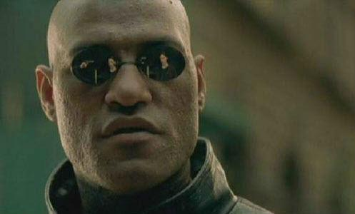
But what if I told you that …

Slide 29

… your web browser is just a media player
Highly interactive media player
You move mouse
Cursor hovers the button
CEF refreshes part of the screen
UI shows new image
Rendering
Up to 60 FPS
When frame appears it means participant can see web page
Read more
Notes:
It is happening with high frequency up to 60 fps
To read more please follow the link

Slide 30
Weighted approach
Type address
nytimes.com
Resolve address
https://nytimes.com
Page load
Page load starts
Page is visible
nytimes.com
First render event
Start TOI
Title changes
Inject scripts
Notes:
So let’s start our TOI from the moment when first frame appears in your interactive media player
And additionally inject some useful javascript code

Slide 31
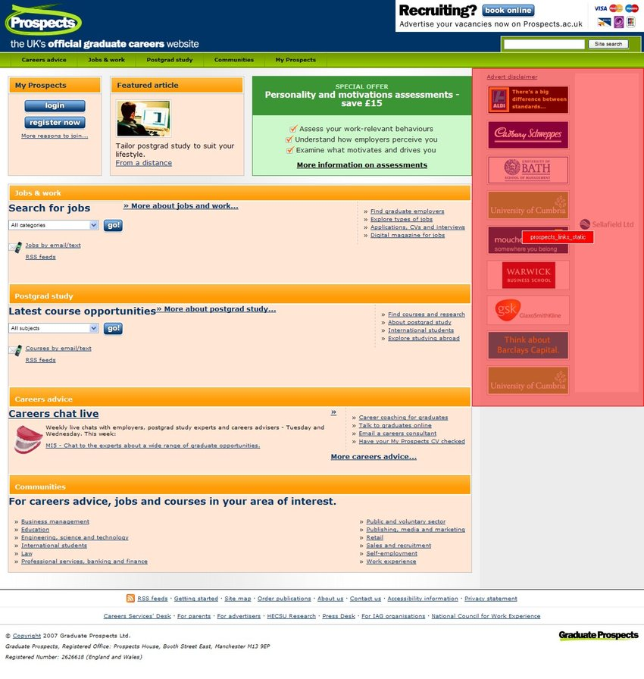
Concepts
TOI - When
AOI - Where
12
9
3
6
Page 1
Page 2
Page 1
Page 3
Source: Researchgate.com
Notes:
Ok well everything fell into the place with toi but toi itself is not so informative because it only says WHEN
It is not so informative as in interception with AREA OF INTEREST which says WHEre
AOI is the main tobii pro lab concept in terms of the space and of the content and it describes an area where your participant could look at

Slide 32
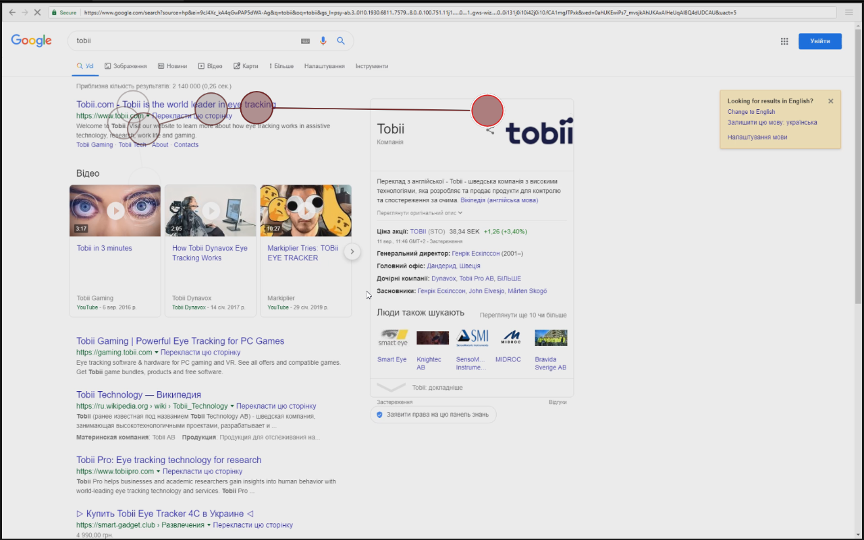
AOI should be drawn on media
Moving AOI on video
Static AOI on screenshot
Source: Researchgate.com, Canva
Notes:
This area should be defined somehow so I means it should be drawn on particular media
In case of web research we emit two types of media:
Video with screen recording where you could draw dynamic AOI for each frame
Screenshot where you could draw static aoi

Slide 33
Take screenshot on page load
Type address
nytimes.com
Resolve address
https://nytimes.com
Page load
Page load starts
Page is visible
nytimes.com
Take screenshot
First render event
Start TOI
Title changes
Inject scripts
Notes:
Following that we need to take screenshot somehow and somewhen
When we were young and naïve we taken screenshot in the moment of page load

Slide 34
Pitfalls of taking screenshot on page load
Highly noticeable UX impact during page interaction
Not all content is loaded yet
The moment of screenshot making could be postponed or even not reached
Notes:
It brought some side effects such as
Noticeable impact due to delay right during first impression
Not all content was loaded to this moment
The moment of screenshot could be postponed or even not reached if say about web pages like newyorktimes.com

Slide 35
Take screenshot before leave the page
Type address
nytimes.com
Resolve address
https://nytimes.com
Page load
Try to leave the page
Page load starts
Page is visible
nytimes.com
First render event
Take screenshot
Start TOI
Title changes
Inject scripts
Notes:
When we gown up we reconsidered our timeline and switched to the approach when we take screenshot before leave the page.
So the participant types new address or clicks a link or so on, we freeze the browser, make screenshot and then let it go

Slide 36
Screenshot making approaches
Approach | Pros | Cons
Headless | No UI/UX impact | Image could be different, sessions handling, needs other approaches
JS code | Ready open-source solution | Visible for participant, image could look differently
Stitched | Limitless size, better fixed elements handling | Highest complexity, potentially different frames during animation, some UI/UX impact especially on huge pages
Chrome API | Easy API | Is not available in CEF ☹
Resize browser | Reliable, atomic | Complexity, duration, and several crucial issues, UI/UX impact
Notes:
Additionally there are several approaches how to take screenshot
Comparing these ways we focused on two of them

Slide 37
Screenshot making approaches
Approach | Pros | Cons
Headless | No UI/UX impact | Image could be different, sessions handling, needs other approaches
JS code | Ready open-source solution | Visible for participant, image could look differently
Stitched | Limitless size, better fixed elements handling | Highest complexity, potentially different frames during animation, some UI/UX impact especially on huge pages
Chrome API | Easy API | Is not available in CEF ☹
Resize browser | Reliable, atomic | Complexity, duration, and several crucial issues, UI/UX impact
Notes:
And started from easiest of two: resize browser

Slide 38
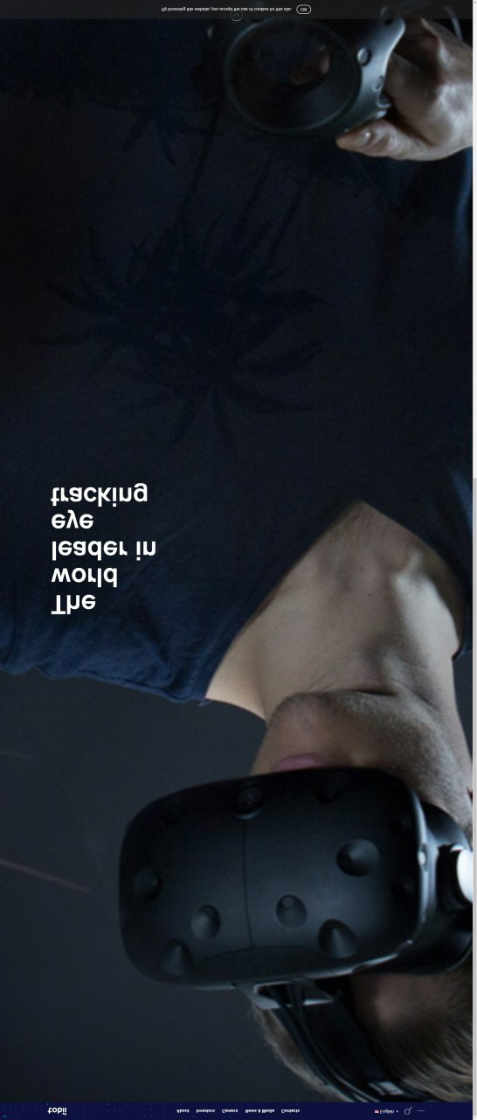
Pitfalls of browser resizing
Hero image issue
Fixed elements attached to the bottom
Partial rendering of the page
Lazy content is not visible
Significant UI/UX impact: blink
CEF unable to resize to height > 15k px
Notes:
It made us face following pitfalls
You can see this guy with helmet
It had to occypy lets say ninety per cents of your viewport but due to resize of browser it occupies ninety per cents of your full page screenshot

Slide 39
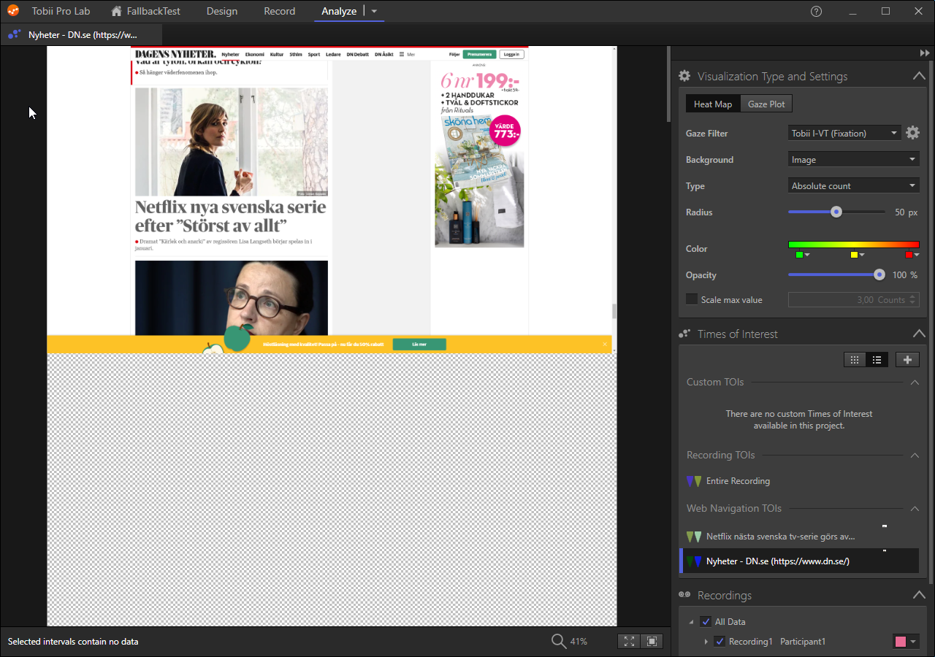
Pitfalls of browser resizing
Notes:
Following screenshot illustrates issue with partial rendering of screenshot by cef asynchronous nature

Slide 40

Problem solver starter pack
Notes:
Let’s uncover problem solver starter pack to handle these issues

Slide 41
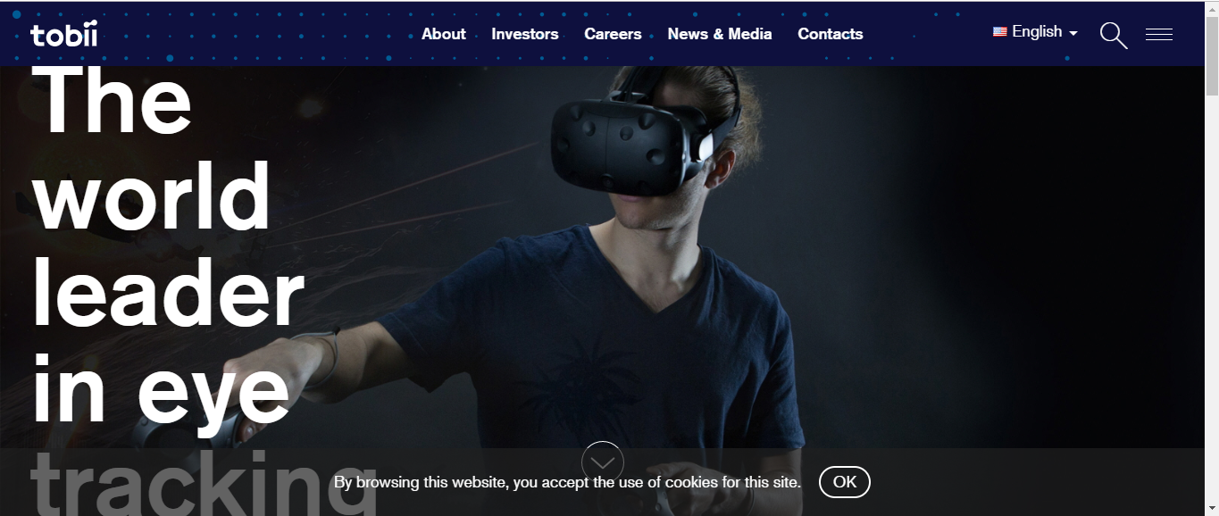
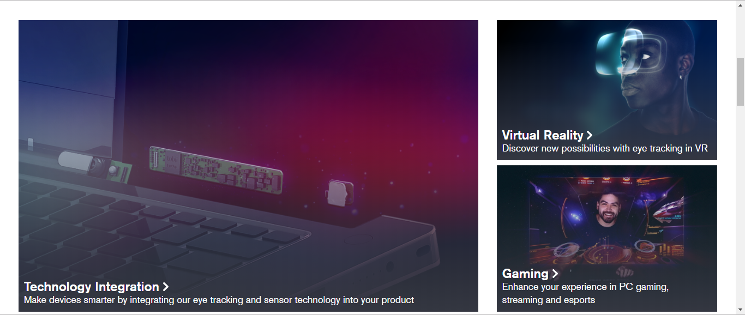

Hey Siri, let’s stitch some screenshot parts
Elements occupy correct sizes
So no hero image issue
Fixed elements appear in viewports
Size limited only by participant machine capabilities
Notes:
We switched to another approach
Here you can see how we take the screenshot of top viewport then scroll down, take the screenshot again and so on
Now we have following results

Slide 42
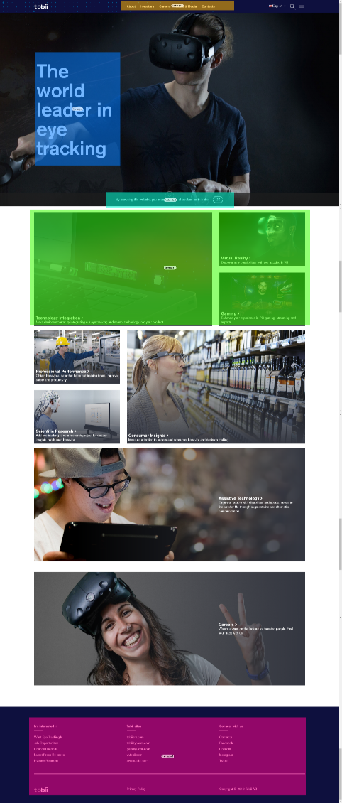
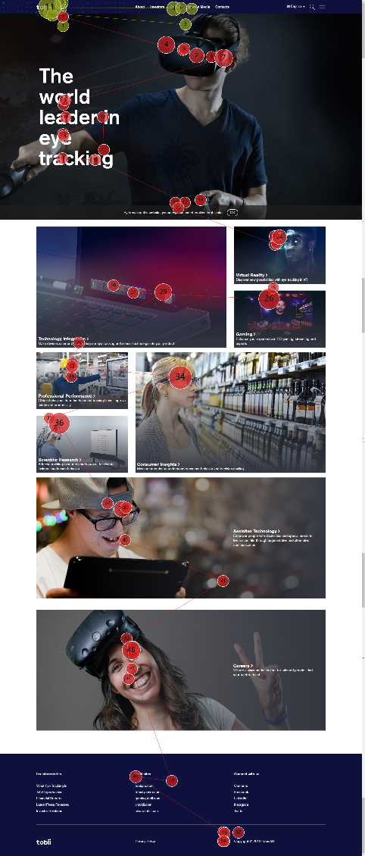
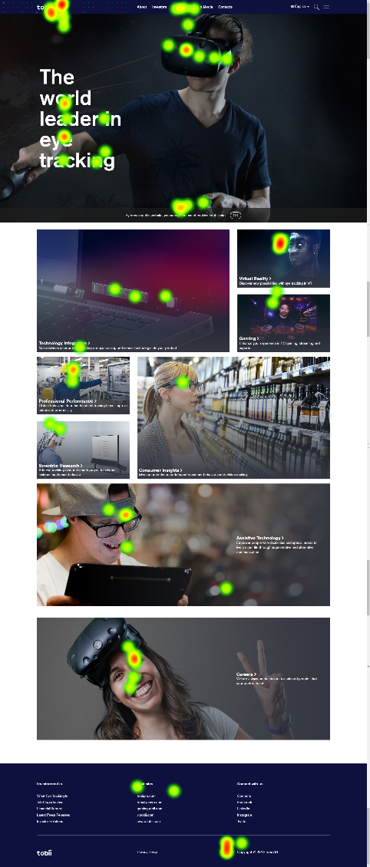
Applying of screenshot and gaze data
Notes:
That’s what we have
We could use this screenshot to draw aoi for some valuable metric of visualize gaze data with heatmap or gaze plot

Slide 43
Translate gaze data
We store all scroll events and could translate gaze data according to viewport offset.
Translated gaze data would be used to calculate metrics, to show the visualization etc.
Read more
43
Notes:
Definitely we should prepare gaze data for that because when we capture it is calculated in the space of your display, but the participant definitely would scroll the page so
We store scroll events, make then some magic and translate gaze data to the space of the screenshot
To read more please follow the link as always

Slide 44
Challenges
Still struggling with
Viewport duplication in case of pages highly saturated by fixed elements
Dynamic fixed elements
Single page applications navigation – actual navigation does not occur
Notes:
Instead of conclusion.
Of course there are still unsolved challenges we faced in work
And lesson learnt

Slide 45
Bonus
Lesson learned:
You could not predict and cover all possible scenarios, let’s focus on most valuable, the www universe is extremely various
But you always could make it better having feedback.
Notes:
Instead of conclusion.
Of course there are still unsolved challenges we faced in work
And lesson learnt

Slide 46

Tack så mycket
This presentation on GitHub
46

Slide 47
Rich text - three columns (30p)
Subtitle (20p)
Subtitle bold (14p)
Subtitle bold (14p)
Subtitle bold (14p)
Body text (12 p)
Body text (12 p)
Body text (12 pt)

Slide 48
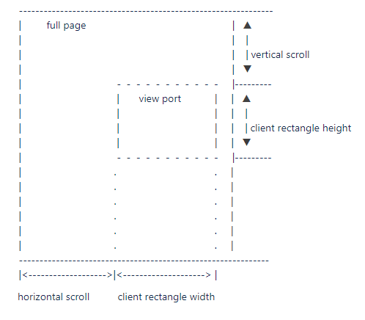
Concepts
Viewport

Slide 49
Rich text - three columns (30p)
Subtitle bold (14p)
Subtitle bold (14p)
Subtitle bold (14p)
Body text (12p)
Body text (12p)
Body text (12p)

Slide 53
Tobii Pro Title bold (36p)
Name (22p)
Title (16p)

Slide 54
How to bake my web research
Yevhen Krupin
Tobii Pro Desktop R&D, Kyiv

Slide 55
Intro
Short introduction to “Tobii Pro Lab” and Web Stimuli

Slide 56
Tobii Pro Title bold (36p)
Name (22p)
Title (16p)

Slide 57
Divider page bold (36p)
Subtitle describing content (22)

Slide 58
Title (30p)
Text (22p)
Second level (16p)
Third level (14p)
Shapes in light grey with dark blue thin border (¼ p)

Slide 59
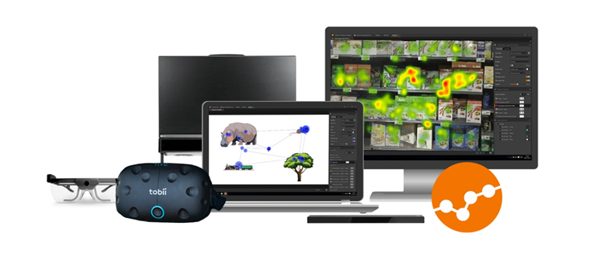
Tobii Pro Lab
Eye tracking software designed for
Conducting experimental research with Tobii Pro hardware
Provide powerful analytics and visualization
Integration with third-party devices and sensors

Slide 60
Colors Tobii Pro
Primary
Secondary
R 243
G 117
B 0
R 238
G 70
B 59
R 253
G 217
B 179
R 179
G 179
B 179
R 65
G 64
B 66
R 144
G 182
B 225
Hyperlink
R 134
G 185
B 255
R 77
G 83
B 215
Text object in dark grey (18p)

Slide 61
Terminology
(20p)
Tobii Pro Lab definitions
Event types and events
TOI and intervals
AOI and visits
Web/UX research definitions
Viewport
Page
Fixes/sticky elements
Read more

Slide 62
Terminology
(20p)
Text (22p)
Second level (16p)
Third level (14p)

Slide 63
Two pieces of content (30p)
Text (22p)
Second level (16p)
Text (22p)
Second level (16p)

Slide 64
Content and graph on right side (30p)
Text (22p)
Second level (16p)

Slide 65
Compare two columns (30p)
Subtitle bold (22p)
Subtitle bold (22p)
Text (22p)
Second level (16p)
Text (22p)
Second level (16p)

Slide 66
Rich text – two columns (30p)
Subtitle (20p)
Subtitle bold (18p)
Subtitle bold (18p)
Body text (14p)
Body text (14p)

Slide 67
Web events
Type address
tobiipro.com
Async stuff
Some asynchronous requests
Page load
Document is loaded now
Resolve address
Still loading
Jag är trött på att vänta…
https://tobiipro.com
Type address
Page load starts
Page is visible
nytimes.com
First render event
Title changes
Type address
Finally loaded
google.com

